Slide 1

Elasticities of Supply
2.6
Copyright Bananomics

Slide 2

Discuss the law of supply with your partner.
What does it mean and is it true for all goods and services?
Copyright Bananomics

Slide 3

Definitions
The extent to which producers react to price changes depends on the value of the elasticity of supply of their product.
Price Elasticity of Supply (PES) - a measure of how much the quantity supplied of a good changes when there is a change in its OWN price
Copyright Bananomics

Slide 4

Formulas
The extent to which the quantity supplied changes depends on how 'elastic' its demand is with respect to its price.
% change in quantity supplied of good x
PES =
% change in price of good x
ALSO WRITTEN AS
%△Qs
%△P
PES =
Copyright Bananomics

Slide 5

Formulas
new - old
% change =
x 100
old
Copyright Bananomics

Slide 6

Try It Out - PED
The price of a pack of gum increases by 10 per cent and, as a result, the quantity supplied of train tickets increases by 5 per cent
What is the PED?
Copyright Bananomics

Slide 7

Try It Out
PES = 0.5
Due to the DIRECT relationship of price and quantity supplied, PEs will always be positive.
Copyright Bananomics

Slide 8
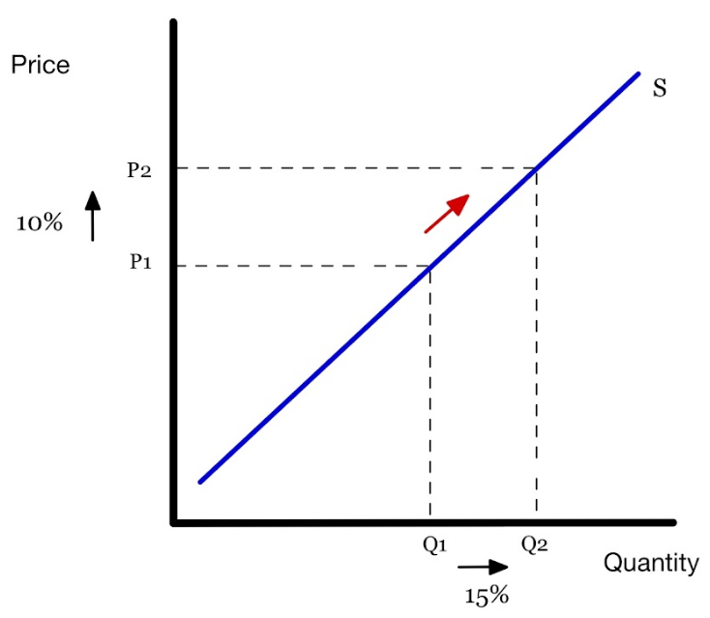
PES > 1
Price Elastic Supply
A change in price leads to a proportionately greater change in the quantity supplied.
The quantity supplied is relatively responsive to price.
Copyright Bananomics

Slide 9
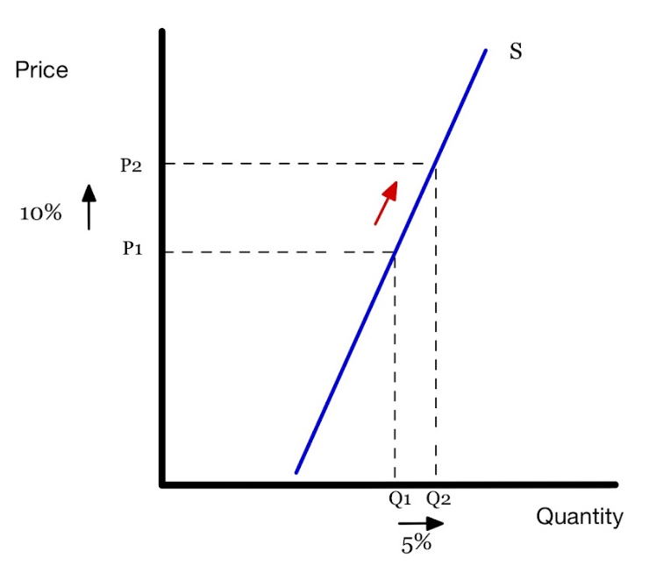
PES = 0-1
Price Inelastic Supply
A change in price leads to a proportionately smaller change in the quantity supplied. The supply is relatively unresponsive to price.
Copyright Bananomics

Slide 10
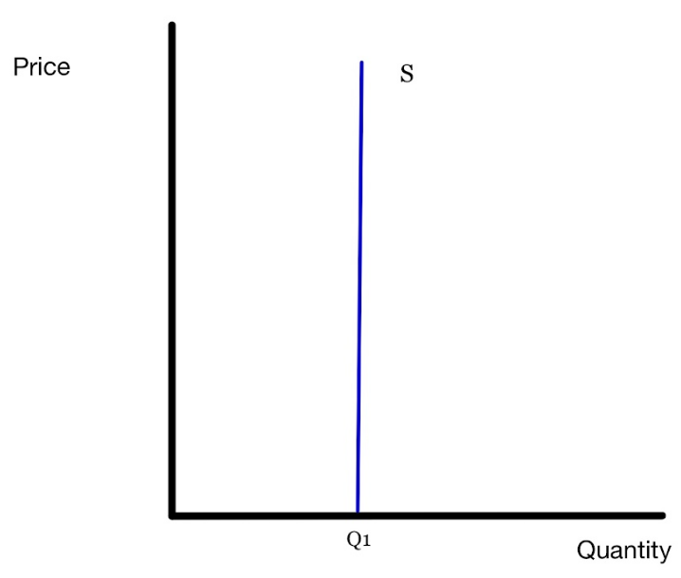
PES = 0
Perfectly Inelastic Supply
A change in price leads to no change in the quantity supplied. The supply is not responsive to price; producers of that good are not sensitive to price changes.
Copyright Bananomics

Slide 11
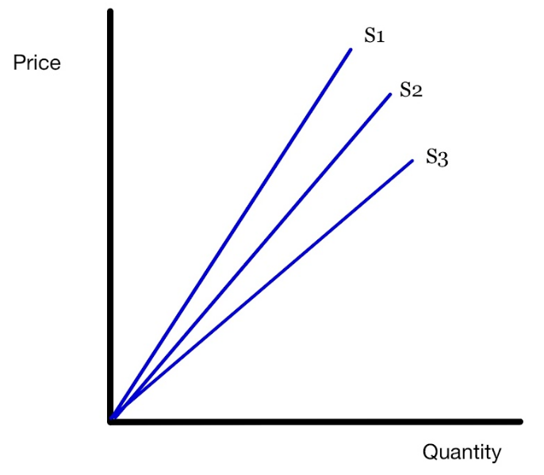
PES = 1
Unit or Unitary Elastic Supply
Any curve that passes through 0,0.
A change in price leads to an equal change in the quantity supplied. Producers are proportionally sensitive to price changes.
Copyright Bananomics

Slide 12

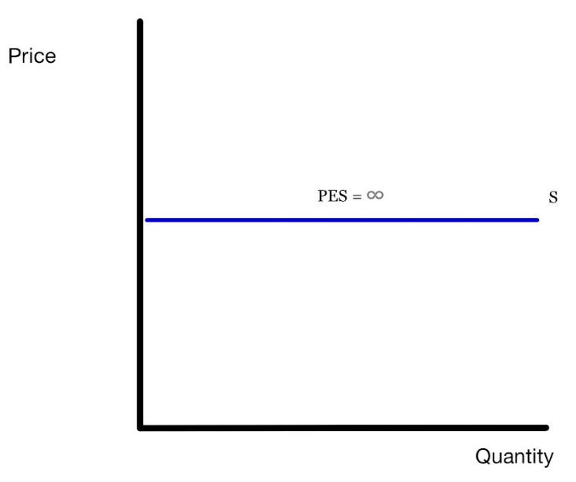
PED =
Perfectly Elastic Supply
A change in price leads to an equal change in the quantity supplied. Producers are proportionally sensitive to price changes.
Copyright Bananomics

Slide 13


CAUTION
Similar to PED, the scenarios of perfect elasticity, inelasticity, and unitary elasticity of PES is rare.
Most examples in the real world will have elastic or inelastic supply curves.
Copyright Bananomics

Slide 14

Determiniants of PES
  Time - How long does it take to produce the good? Can I make a lot in a short period of time?
  Mobility/Flexibility of Production - How flexible are the resources used to make the product? Can it be changed easily?
  Unused Capacity - Is the firm operating at maximum efficiency or can they easily increase their output?
  Storage Ability - Does the firm have the ability to store stock and increase quantity supplied by going to the warehouse? Can the products be stored at all?
  Rate of Production Costs - How expensive and scarce are the resources used? Can they easily obtain more?
Copyright Bananomics

Slide 15

PES of
Primary Commodities vs Manufactured Goods
Copyright Bananomics

Slide 16



Refresher
Primary Commodity
Raw Materials and food such as Agriculture, Gold, Oil, Diamonds
Manufactured Good
Clothes, Machinery, Cars
Copyright Bananomics

Slide 17
Primary Commodities PES
Due to the high investment and long time periods of work, primary commodities typically have a low PES (inelastic supply) compared to manufactured goods.
Example
A farmer must wait an entire planting season to respond to changes in price. They cannot simply increase their crop yields to increase Qs.
Copyright Bananomics

Slide 18

Enjoying The Content?
Visit bananaomics.com to purchase package deals with discount prices!
BANANAOMICS

